Slide 1
Water Pollution
Notes:
‹#›

Slide 2
Water Pollution: Types, Effects, and Sources
What is water pollution?
Major types of pollutants, sources and effects
Point and nonpoint sources
Is the water safe to drink?
Notes:
‹#›

Slide 3
Major Categories of Water Pollutants
Infectious Agents
Bacteria, Viruses, Protozoa, Parasitic Worms
Source: Human and animal waste
Oxygen-Demanding Waste
Organic debris & waste + aerobic bacteria
Source: Sewage, feedlots, paper-mills, food processing
Inorganic Chemicals
Acids, Metals, Salts
Sources: Surface runoff, Industrial effluent, household cleansers
Radioactive Materials
Iodine, radon, uranium, cesium, thorium
Source: Coal & Nuclear Power plants, mining, weapons production, natural
Plant Nutrients
Nitrates, Phosphates,
Source: Sewage, manure, agricultural and landscaping runoff
Organic Chemicals
Oil, Gasoline, Plastics, Pesticides, Solvents, detergents
Sources: Industrial effluent, Household cleansers, runoff from farms and yards
Eroded Sediment
Soil, Silt
Heat/Thermal Pollution
Source: Power plants, Industrial
Notes:
‹#›

Slide 4
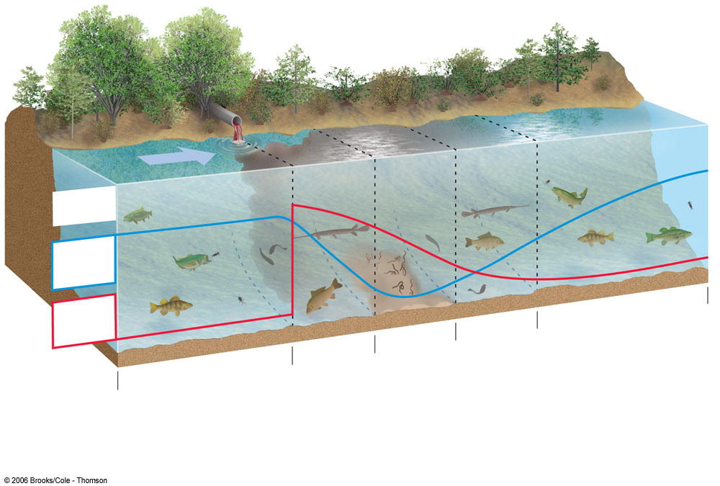
Pollution in Streams
Normal clean water organisms
(trout, perch, bass,
mayfly, stonefly)
Fish absent, fungi,
sludge worms,
bacteria
(anaerobic)
Trash fish
(carp, gar,
leeches)
Normal clean water organisms
(trout, perch, bass,
mayfly, stonefly)
Trash fish
(carp, gar,
leeches)
8 ppm
Types of
organisms
Dissolved oxygen (ppm)
8 ppm
Biological oxygen
demand
Clean Zone
Recovery Zone
Septic Zone
Decomposition
Zone
Clean Zone
Notes:
‹#›

Slide 5
Benefits of Floodplains
Highly productive wetlands
Provide natural flood and erosion control
Maintain high water quality
Recharge groundwater
Fertile soils
Nearby rivers for use and recreation
Flatlands for urbanization and farming
Notes:
‹#›

Slide 6
Dangers of Floodplains and Floods
Deadly and destructive
Human activities worsen floods
Failing dams and water diversion
Bangladesh
Notes:
‹#›

